Slide 1

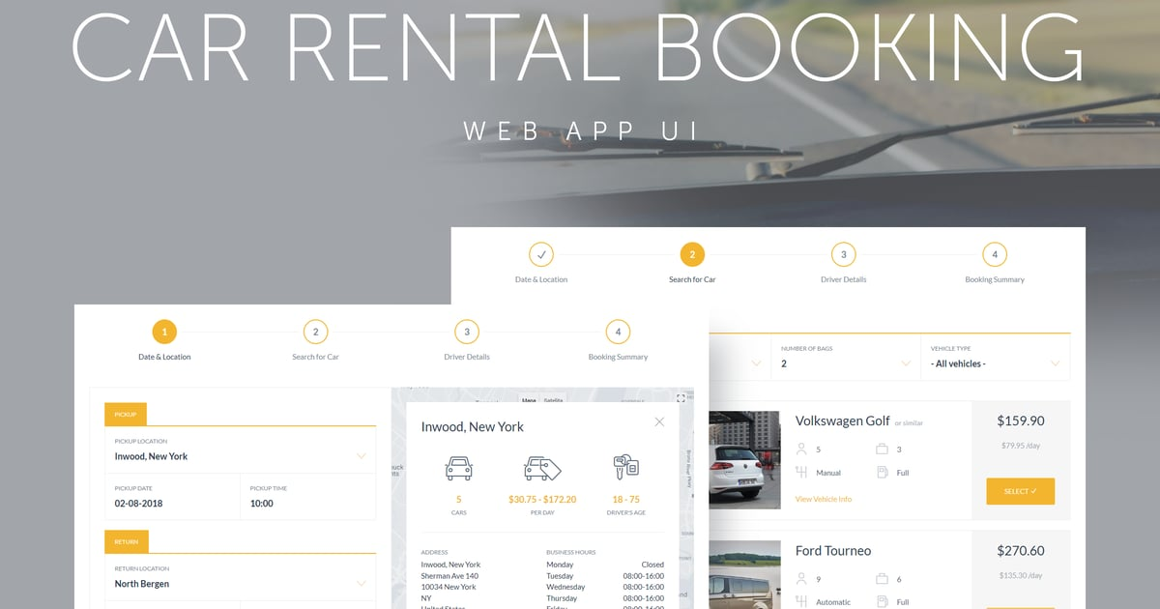
Final Project:

Slide 2
Title Slide
Title: Booking System
Subtitle: Final Project Presentation
Tanzeel Abbas
Basharat suad
Department: BS Computer Science

Slide 3
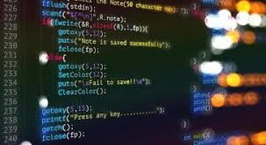


Introduction:
The Booking System is a C++ program designed for room and car reservations.
Provides an efficient way to book rooms and
rent cars with user-friendly billing.
Features structured programming, input
validation, and formatted output.

Slide 4



System Specifications:
Programming Language:
Main Features:
User Input & Output:
C++
Room and Car Booking
Customer Information Collection
Bill Calculation with Tax
Random Customer ID Generation
Users select a service.
The system displays available options.
Customer details are collected and a final bill is generated.

Slide 5
start
Flow chart:
Display Booking option:
1.Room Booking
2.Car booking
User Selection
Display rooms Option
Display Car Rental Option
User Selects:
-Room Type
-Quantity
-Duration
User Selects:
-Rental Type
-Duration
Collect Customer Information
Calculate and Display Final Bill
End

Slide 6
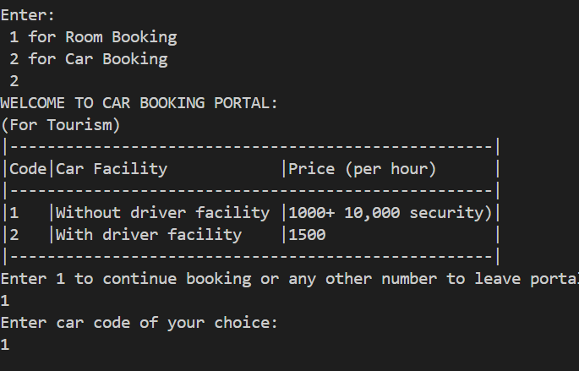
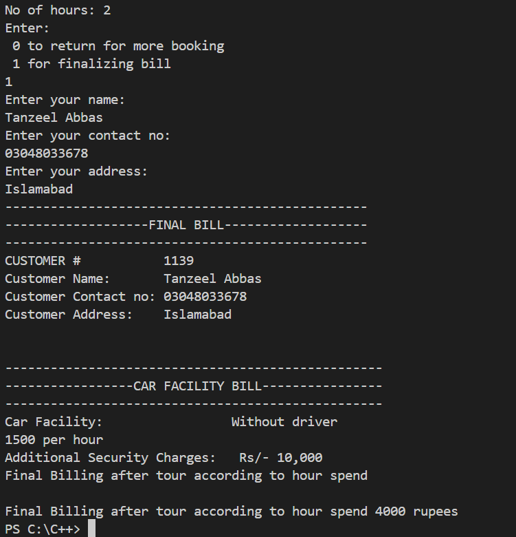
Final Bill Output Example:

Slide 7
References & Conclusion:
References:
C++ Documentation (cplusplus.com)
Online tutorials on formatted output & structured programming.
Conclusion:
The system efficiently handles room & car reservations.
Uses structured programming & user-friendly interface.
Can be expanded with additional features like online payment integration.

